Slide 1
C++ OOP Object-Oriented Programming

Slide 2
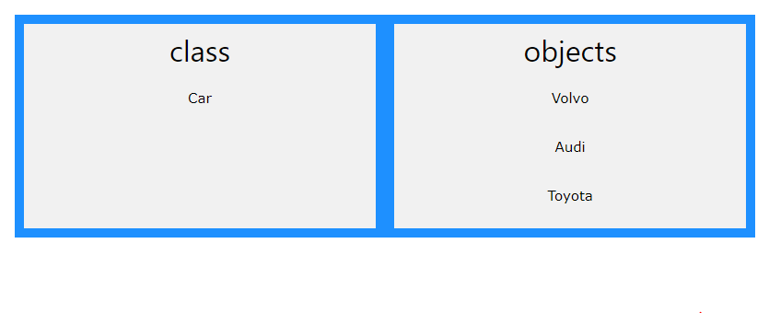

Slide 3
Create a Class
class MyClass // The class
{
public: // Access specifier int myNum; // Attribute (int variable) string myString; // Attribute (string variable) };

Slide 4
Create an Object
class MyClass { // The class public: // Access specifier int myNum; // Attribute (int variable) string myString; // Attribute (string variable) }; int main()
{ MyClass myObj; // Create an object of MyClass // Access attributes and set values myObj.myNum = 15; myObj.myString = "Some text"; // Print attribute values cout << myObj.myNum << "\n"; cout << myObj.myString; return 0; }

Slide 5
#include <iostream>
using namespace std;
class Box
{
public:
double length; // Length of a box
double breadth; // Breadth of a box
double height; // Height of a box
};
int main()
{
Box Box1; // Declare Box1 of type Box
Box Box2; // Declare Box2 of type Box
double volume = 0.0; // Store the volume of a box here
Box1.height = 5.0; // box 1 specification
Box1.length = 6.0;
Box1.breadth = 7.0;
Box2.height = 10.0; // box 2 specification
Box2.length = 12.0;
Box2.breadth = 13.0;
volume = Box1.height * Box1.length * Box1.breadth; // volume of box 1
cout << "Volume of Box1 : " << volume <<endl;
volume = Box2.height * Box2.length * Box2.breadth; // volume of box 2
cout << "Volume of Box2 : " << volume <<endl; return 0;
}

Slide 6
// Create a Car class with some attributes class Car { public: string brand; string model; int year; }; int main() { // Create an object of Car Car carObj1; carObj1.brand = "BMW"; carObj1.model = "X5"; carObj1.year = 1999; // Create another object of Car Car carObj2; carObj2.brand = "Ford"; carObj2.model = "Mustang"; carObj2.year = 1969; // Print attribute values cout << carObj1.brand << " " << carObj1.model << " " << carObj1.year << "\n"; cout << carObj2.brand << " " << carObj2.model << " " << carObj2.year << "\n"; return 0; }

Slide 7
Class Methods
Methods are functions that belongs to the class.
class MyClass { // The class public: // Access specifier void myMethod()
{ // Method/function defined inside the class cout << "Hello World!"; } }; int main()
{ MyClass myObj; // Create an object of MyClass myObj.myMethod(); // Call the method return 0; }

Slide 8
class MyClass { // The class public: // Access specifier void myMethod(); // Method/function declaration }; // Method/function definition outside the class void MyClass::myMethod() { cout << "Hello World!"; } int main() { MyClass myObj; // Create an object of MyClass myObj.myMethod(); // Call the method return 0; }

Slide 9
Constructors
A constructor in C++ is a special method that is automatically called when an object of a class is created.
class MyClass { // The class public: // Access specifier MyClass() // Constructor
{ cout << "Hello World!"; } }; int main() { MyClass myObj; // Create an object of MyClass (this will call the constructor) return 0; }

Slide 10
Constructor Parameters
class Car { // The class public: // Access specifier string brand; // Attribute string model; // Attribute int year; // Attribute Car(string x, string y, int z) { // Constructor with parameters brand = x; model = y; year = z; } }; int main() { // Create Car objects and call the constructor with different values Car carObj1("BMW", "X5", 1999); Car carObj2("Ford", "Mustang", 1969); // Print values cout << carObj1.brand << " " << carObj1.model << " " << carObj1.year << "\n"; cout << carObj2.brand << " " << carObj2.model << " " << carObj2.year << "\n"; return 0; }

Slide 11
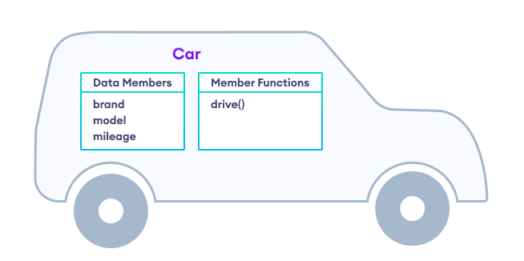
class Car
{
public:
// class data
string brand, model;
I int mileage = 0;
// class function
void drive(int distance)
{
mileage += distance;
}
} ;

Slide 12
#include <iostream>
using namespace std;
class Car {
public:
// class data
string brand, model;
int mileage = 0;
// class function to drive the car
void drive(int distance) {
mileage += distance;
}
// class function to print variables
void show_data() {
cout << "Brand: " << brand << endl;
cout << "Model: " << model << endl;
cout << "Distance driven: " << mileage << " miles" << endl;
}
};
int main() {
// create an object of Car class
Car my_car;
// initialize variables of my_car
my_car.brand = "Honda";
my_car.model = "Accord";
my_car.drive(50);
// display object variables
my_car.show_data();
return 0;
}

Slide 13
class Car { // The class public: // Access specifier string brand; // Attribute string model; // Attribute int year; // Attribute Car(string x, string y, int z); // Constructor declaration }; // Constructor definition outside the class Car::Car(string x, string y, int z) { brand = x; model = y; year = z; } int main() { // Create Car objects and call the constructor with different values Car carObj1("BMW", "X5", 1999); Car carObj2("Ford", "Mustang", 1969); // Print values cout << carObj1.brand << " " << carObj1.model << " " << carObj1.year << "\n"; cout << carObj2.brand << " " << carObj2.model << " " << carObj2.year << "\n"; return 0; }

Slide 14
Access Specifiers
public - members are accessible from outside the class
private - members cannot be accessed (or viewed) from outside the class
protected - members cannot be accessed from outside the class, however, they can be accessed in inherited classes
class MyClass { public: // Public access specifier int x; // Public attribute private: // Private access specifier int y; // Private attribute }; int main() { MyClass myObj; myObj.x = 25; // Allowed (public) myObj.y = 50; // Not allowed (private) return 0; }

